Slide 1
Understanding Neighborhoods
With Foursquare Venue Data

Slide 2
Data Enabled Relocation
Provide a means to reduce the cost and effort needed to choose a suitable neighborhood in a new city
Find key targets for neighborhoods with similar structure to an existing neighborhood in another city
Data to be used is the Foursquare venue database

Slide 3
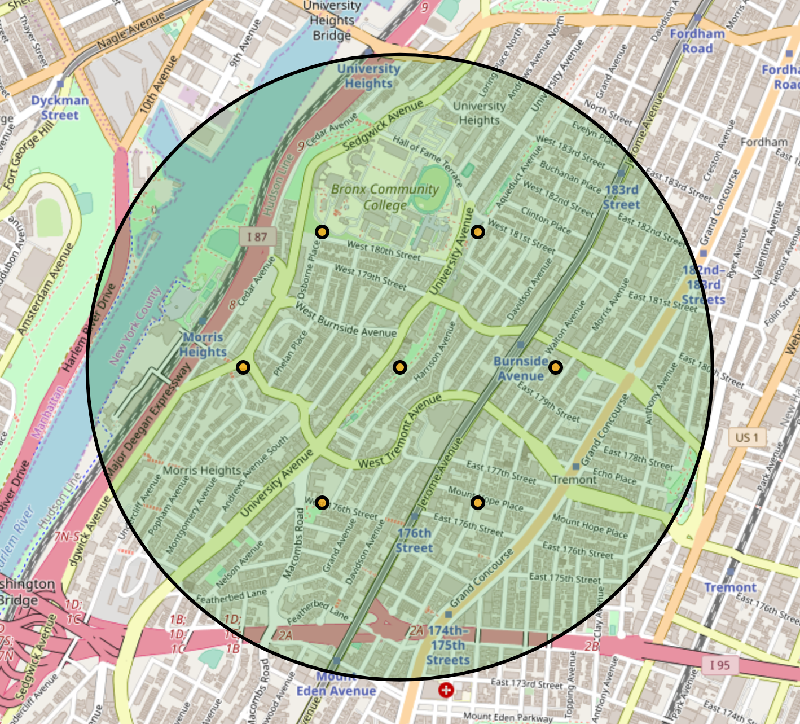
Data Aquisition
Data was collected by directing multiple queries in a 0.5 km radius circle around the geocoordinates of each neighborhood.
Retrieved venues without coded categories were dropped.
This left 140,227 venues in New York, and 71,040 venues in Toronto
A network of 7 query targets
used to query the database

Slide 4
Data Engineering
A map of venue category to 10 category groups was developed from the hierarchical relationships published by FourSquare
Venue categories within each category group were counted for each category group. These counts became the features used for cluster analysis.
Aggregated category data was grouped and counted for each neighborhood, leaving a data set consisting of 270 neighborhoods, each with 10 features:
Arts & Entertainment | College and University | Event | Food | Nightlife Spot
Outdoors and Recreation | Professional and Other | Residence | Shop or Service | Travel and Transport

Slide 5
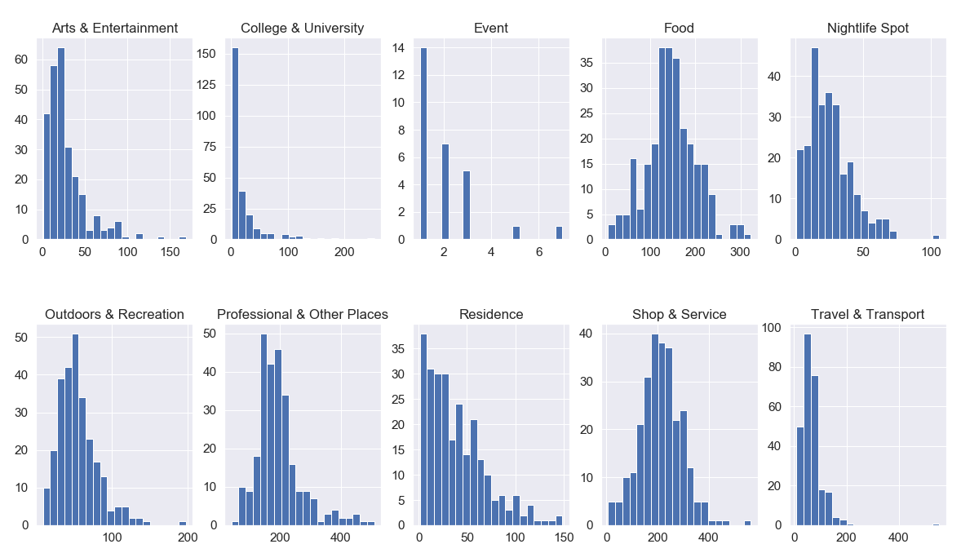
Data Exploration
Data for one feature, Events was found to be sparse and inconsistently used within the database.
The Events Feature was dropped from analysis
Histograms of Feature Values (venue counts)

Slide 6
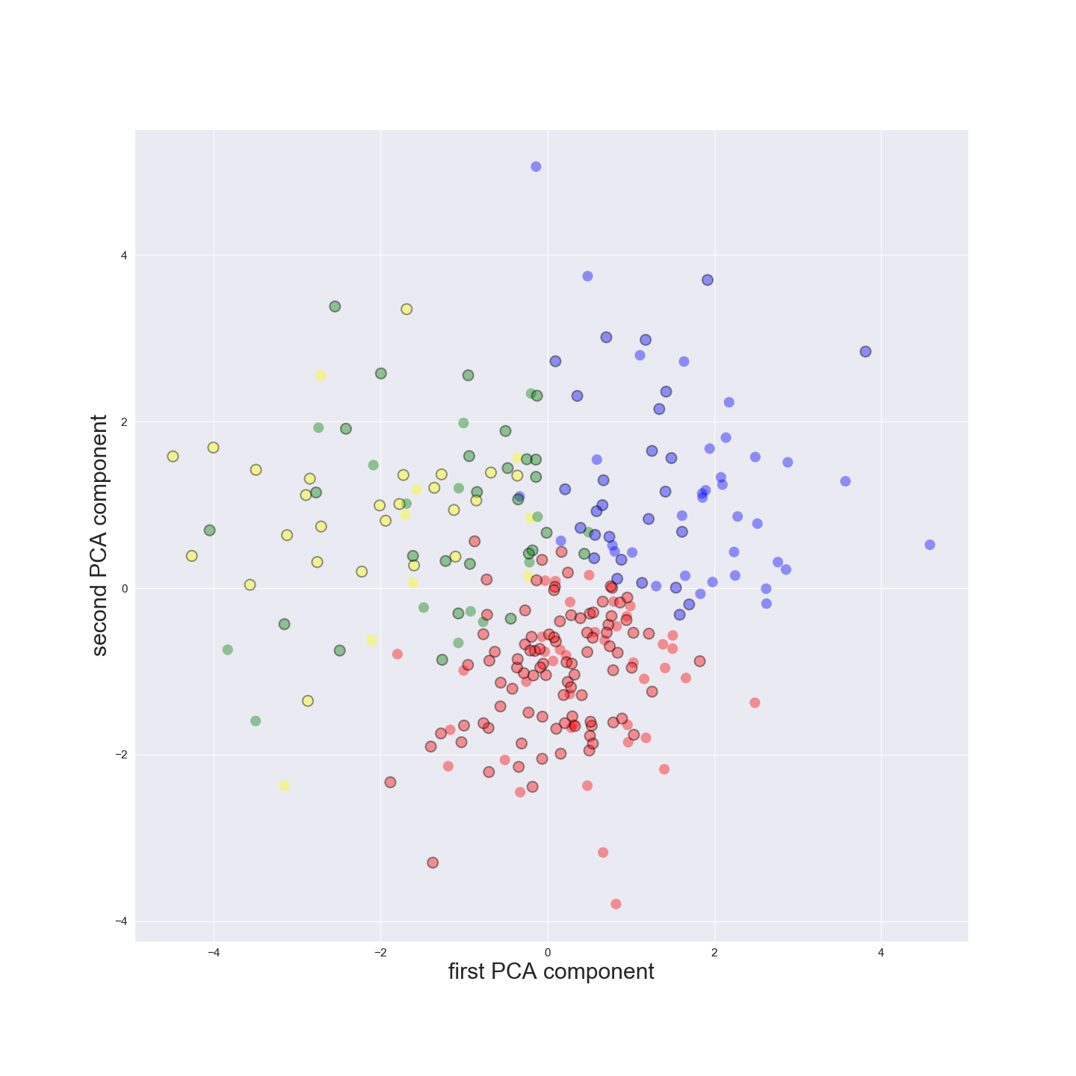
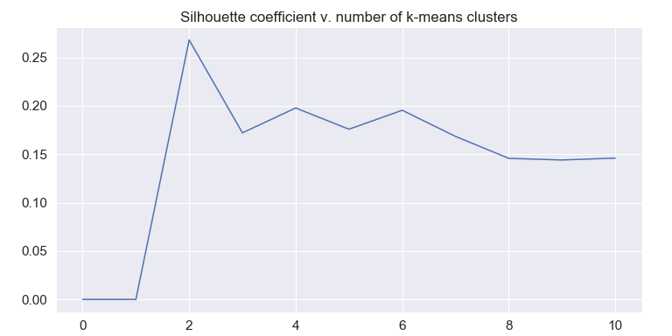
Data Analysis
Clustering of Neighborhoods provided some value, removing 65% + of neighborhoods as candidates.
Results still left Too many neighborhoods to provide a concise relocation search.
In Addition the resulting silhouette coefficients, all less than 0.20 for 3 ≦ k ≦ 5, suggested that the resulting clusters were based on insufficient structure found in the underlying dataset
Clusters: k=4 ( 2 Component PCA projection)
Average silhouette coefficients, k=2 to k=10

Slide 7
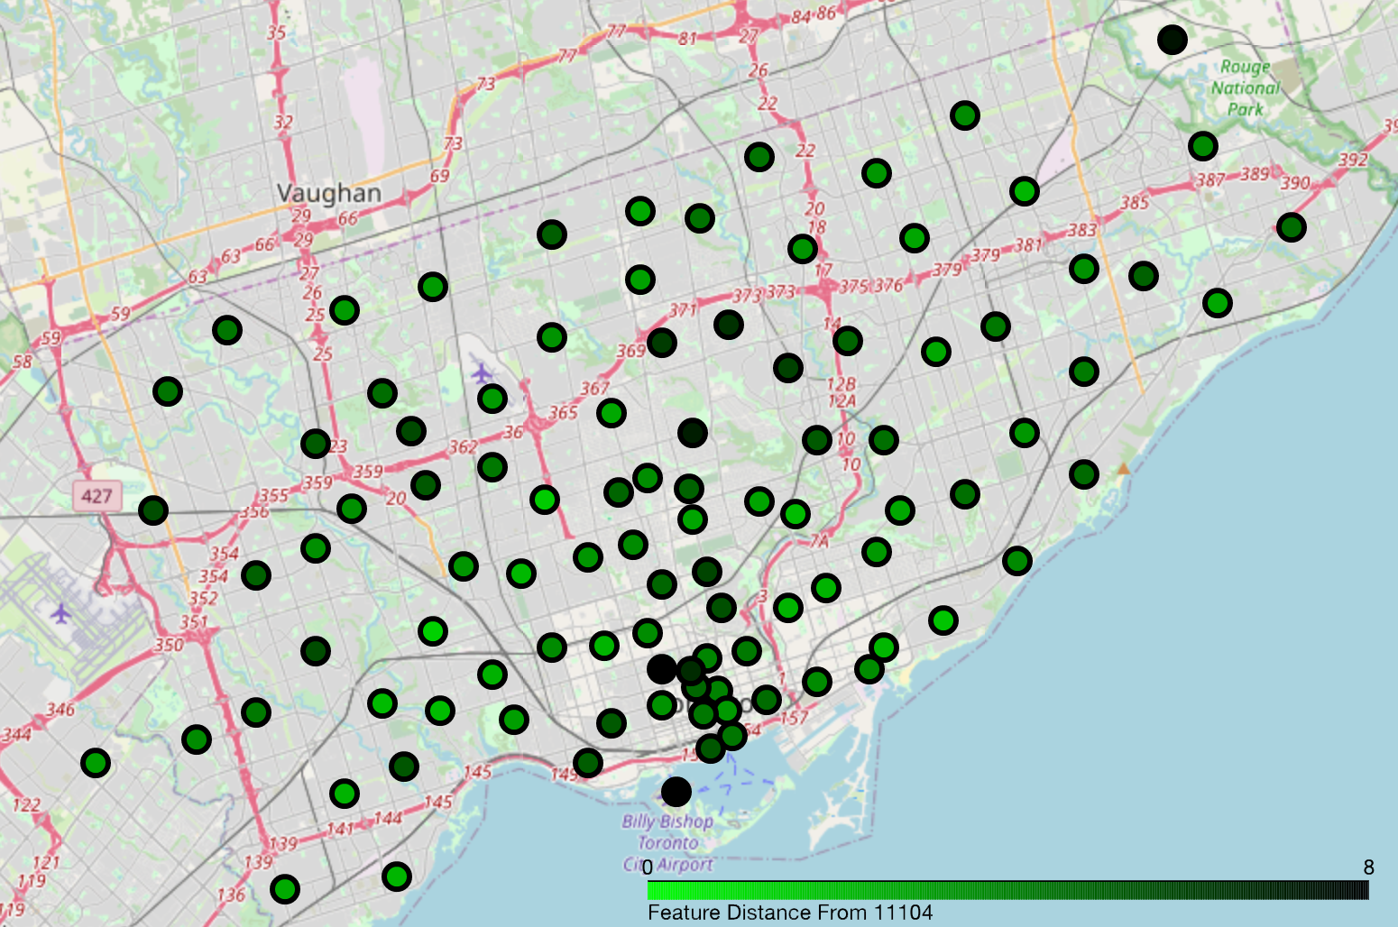
Alternate Approach
Absolute Euclidean feature distance was used to compare neighborhoods
The feature distance from the home neighborhood was calculated for all Toronto Neighborhoods
The results were plotted onto a map of Toronto, with best candidate neighborhoods visualized in bright greed.
Euclidean Distance for Toronto Neighborhoods, based on features scaled to μ=0, σ = 1. Neighborhoods that closely match the home neighborhood show as brighter green

